Slide 1


ANALYTICS SHOWCASE
What makes a loyal customer?
PRESENTED BY NATE SMITH & KAITLYN COMMES

Slide 2



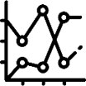

Agenda
Initial Look
Further Analysis
1
3
2
4
Machine Learning
Suggestions

Slide 3

Initial Look
361,559
total rows of data
34%
of buyers have subsequent purchases
Missing Data
Post Satisfaction Survey (360,340)
Feature dropped from all records
Customer Income (49,091)
Missing fields filled with median
Customer Gender (35,758)
Distribution of non-nulls used to fill
Distance to Dealer (6,162)
Distribution of non-nulls used to fill
All records with this field missing had exactly one subsequent purchase
Customer Age (1,154)
Missing fields filled with median
Purchase Price (3)
Records with missing field dropped

Slide 4
Loyal =
Any customer with non-zero subsequent purchases

Slide 5
Data Distributions

Slide 6

Feature Distributions – Customer Data

Slide 7
Feature Distributions – Customer Data

Slide 8
Feature Distributions – Vehicle Data

Slide 9
Feature Distributions – Vehicle Data

Slide 10
Feature Distributions – Dealership Data

Slide 11
Statistical Processing & Machine Learning

Slide 12
Overview & Preparation
Feature | Score
distance_missing | 11869.9
customer_distance_to_dealer | 1093.4
customer_previous_purchase | 698.3
trade_in | 365.5
customer_income | 349.2
vehicle_warranty_used | 133.0
vehicle_financing | 93.3
income_missing | 82.1
customer_gender | 59.3
purchase_price | 23.7
distance_binned | 23.4
purchase_make_cat | 7.3
purchase_vehicle_year | 2.1
make_popularity | 0.7
customer_age | 0.2
Bring up anomaly again
Again point to less than mile thing
We saw mean shift here
Saw mean shift
Saw upward trend
Saw mean shift
Explain why this is basically same as financing

Slide 13
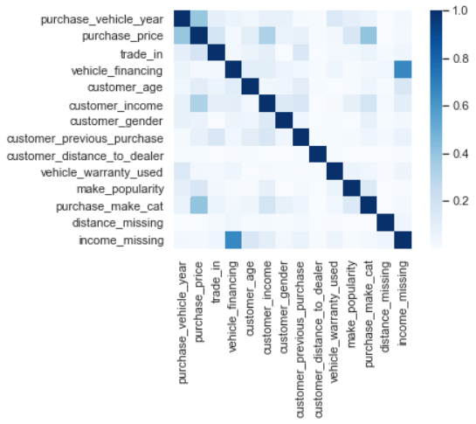
Overview & Preparation
Random Forest machine learning using all the features was leveraged
Branching algorithms can tell us feature importance's
Feature importance's tell which features were the most influential on predictions and can help narrow analysis

Slide 14
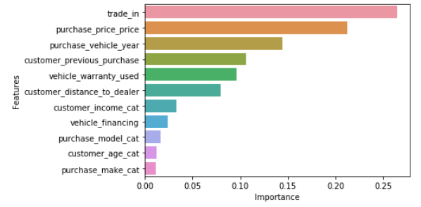
Conclusions/Comparing Results
Explanation of features

Slide 15
Further Analysis & Suggestions

Slide 16
(niche cars)
Overall average loyalty rate

Slide 17
Car aficionados who purchase very niche makes & models have higher rates of loyalty.
Use targeted online marketing to advertise rare/high-end car availability at fair prices.

Slide 18
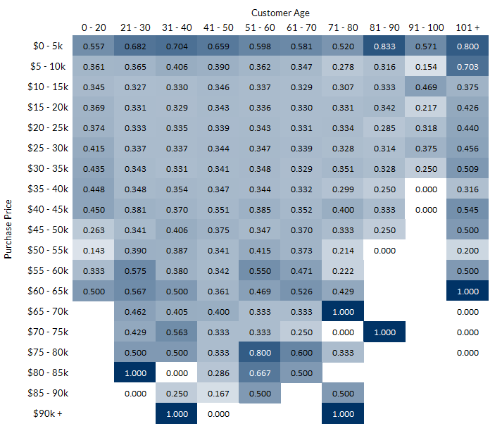

(later slide – age and purchase price)

Slide 19
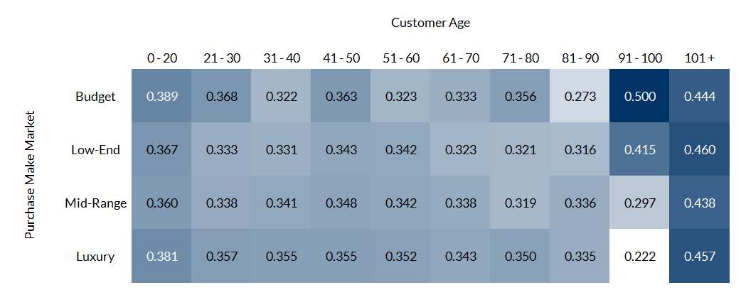
(later slide – possible alternative to above slide, easier to look at but tells a little less)

Slide 20
Insight 2
Suggestion 2

